Slide 1
Christiana Boarding Pass
Mobile Application Problem
By: Shadi Shaaban

Slide 2
Description
The goal of the solution is to provide appointment scheduling functionality through a hybrid mobile application using appointment ID & patient last name
Technologies used:
Hybrid AngularJS+Cordova Mobile Application (Front-end)
Java Spring + Hibernate (Back-end).

Slide 3
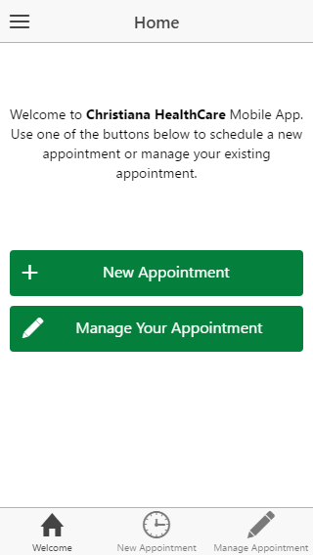
Screenshots
Home Screen:
Provides quick access to main functionality:
Schedule new appointment.
Manage existing one.

Slide 4
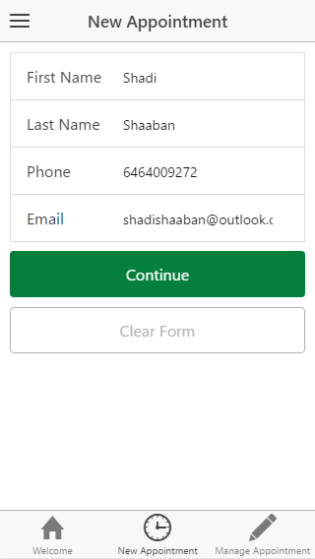
Screenshots
New Appointment:
Asks the user to input basic info like the first name, last name and phone, last name will be used later for managing the appointment.

Slide 5
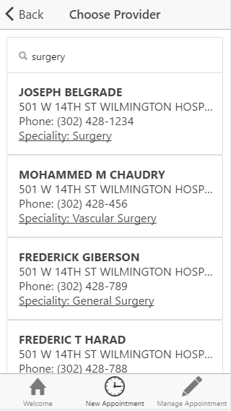
Screenshots
Choosing a Provider
After filling basic info, the user would be prompted with a screen to look up service providers using keyword.

Slide 6
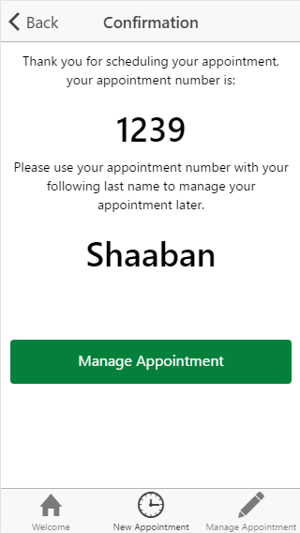
Screenshots
Confirmation
As in flight ticket confirmation, the user is presented with his new appointment id and his last name to be able to manage his booking later.

Slide 7
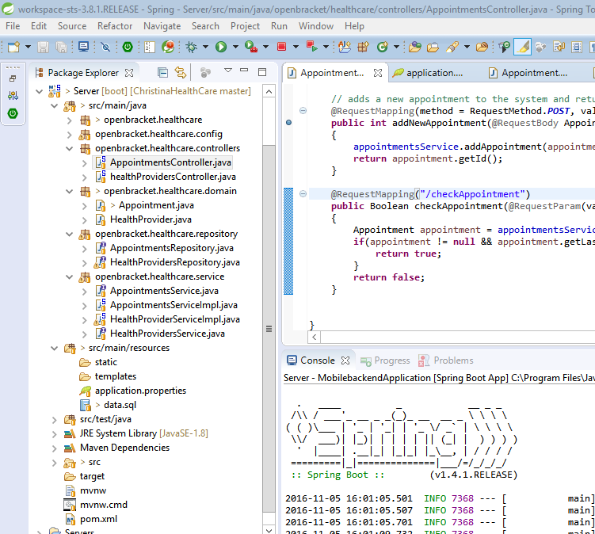
How to run back-end?
The project uses Java Spring Framework with Hibernate, running the Server project on Eclipse will bring up the back-end server at:
http://localhost:8182/

Slide 8

How to run front-end (android APK)?
The project android APK file is available at:
“.\Mobile\platforms\android”
The APK is available at:
“.\Mobile\platforms\android\build\outputs\apk\androind-debug.apk”

Slide 9
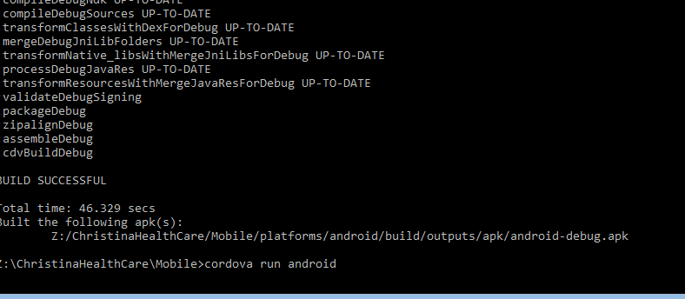
How to run front-end (as cordova)?
The project uses cordova + angularJS for front-end, in case you have cordova installed, execute:
“Cordova run android”
Inside the Mobile folder.

Slide 10
Thank you
Shadi Shaaban
Phone: 646-400-9272
ShadiShaaban@outlook.com

